Slide 1
Creative Guidelines

Slide 2
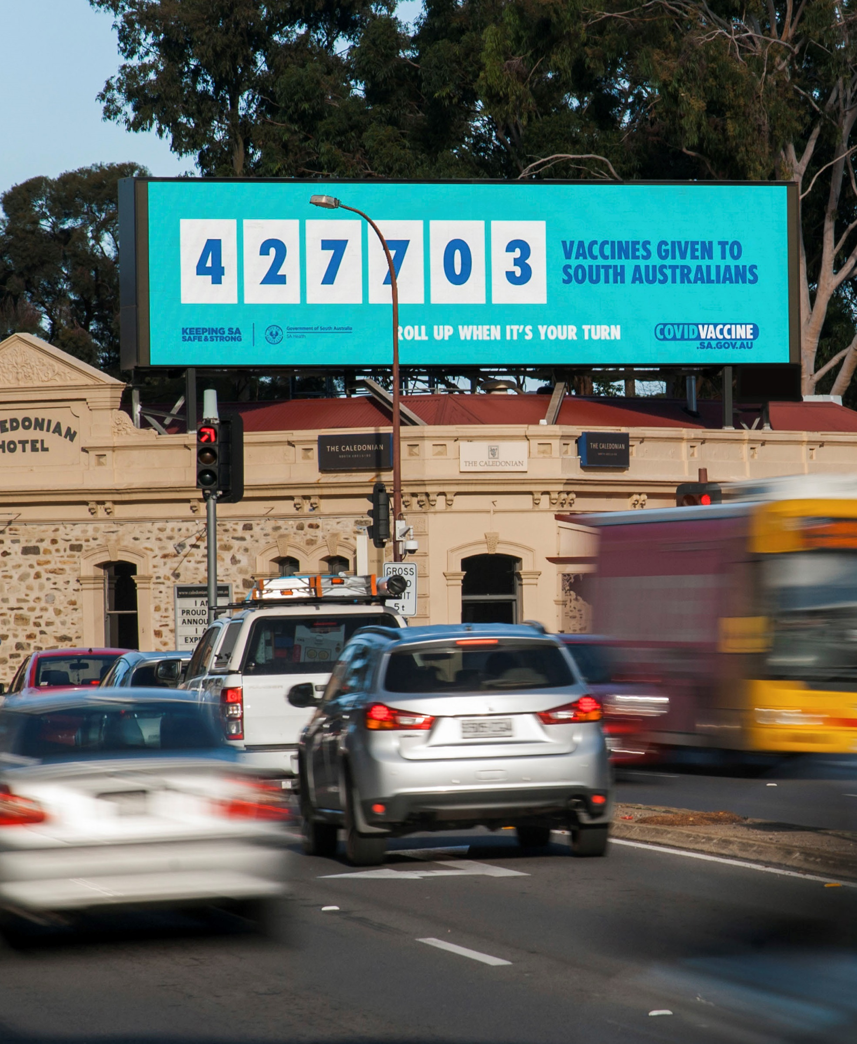
Creative Concept
Informative
Entertaining
Surprising
Humorous
Informative
Emotional

Slide 3
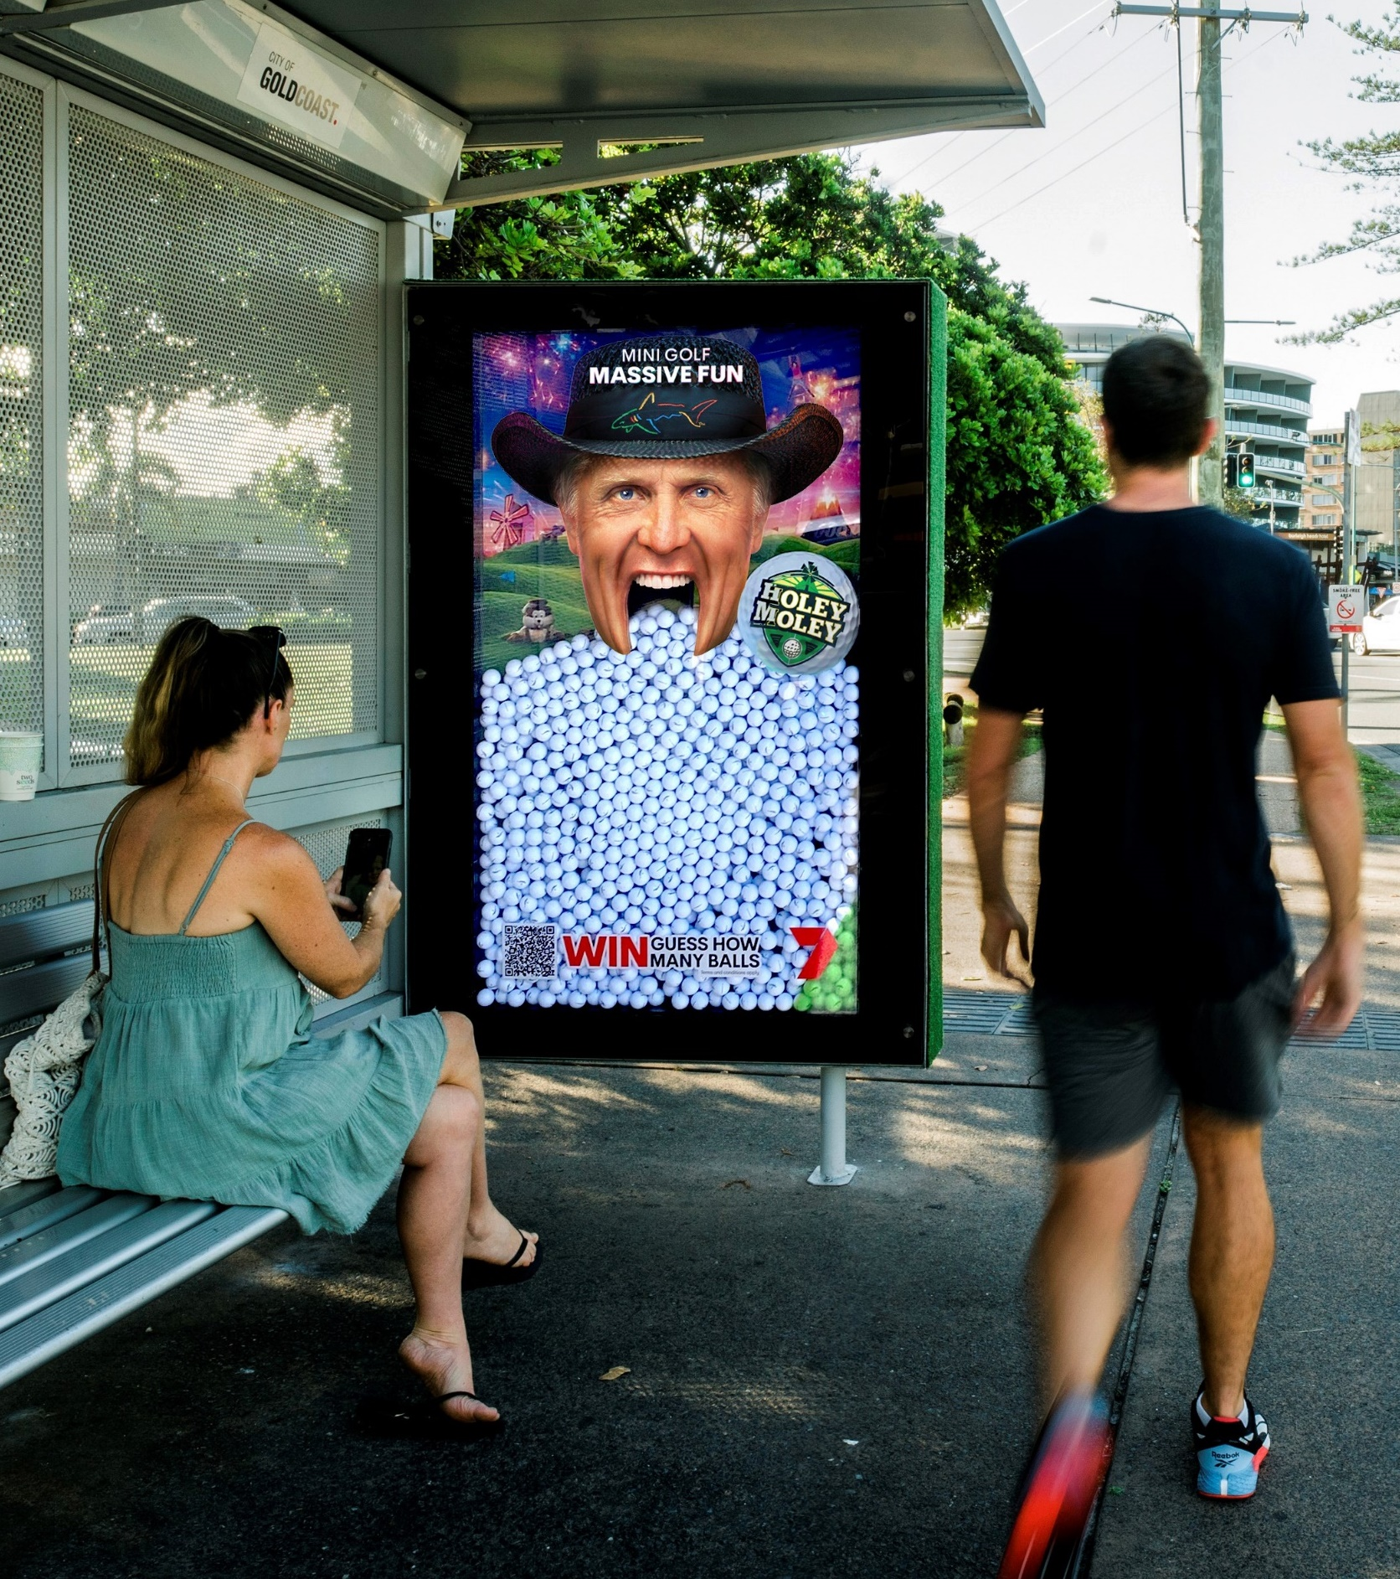
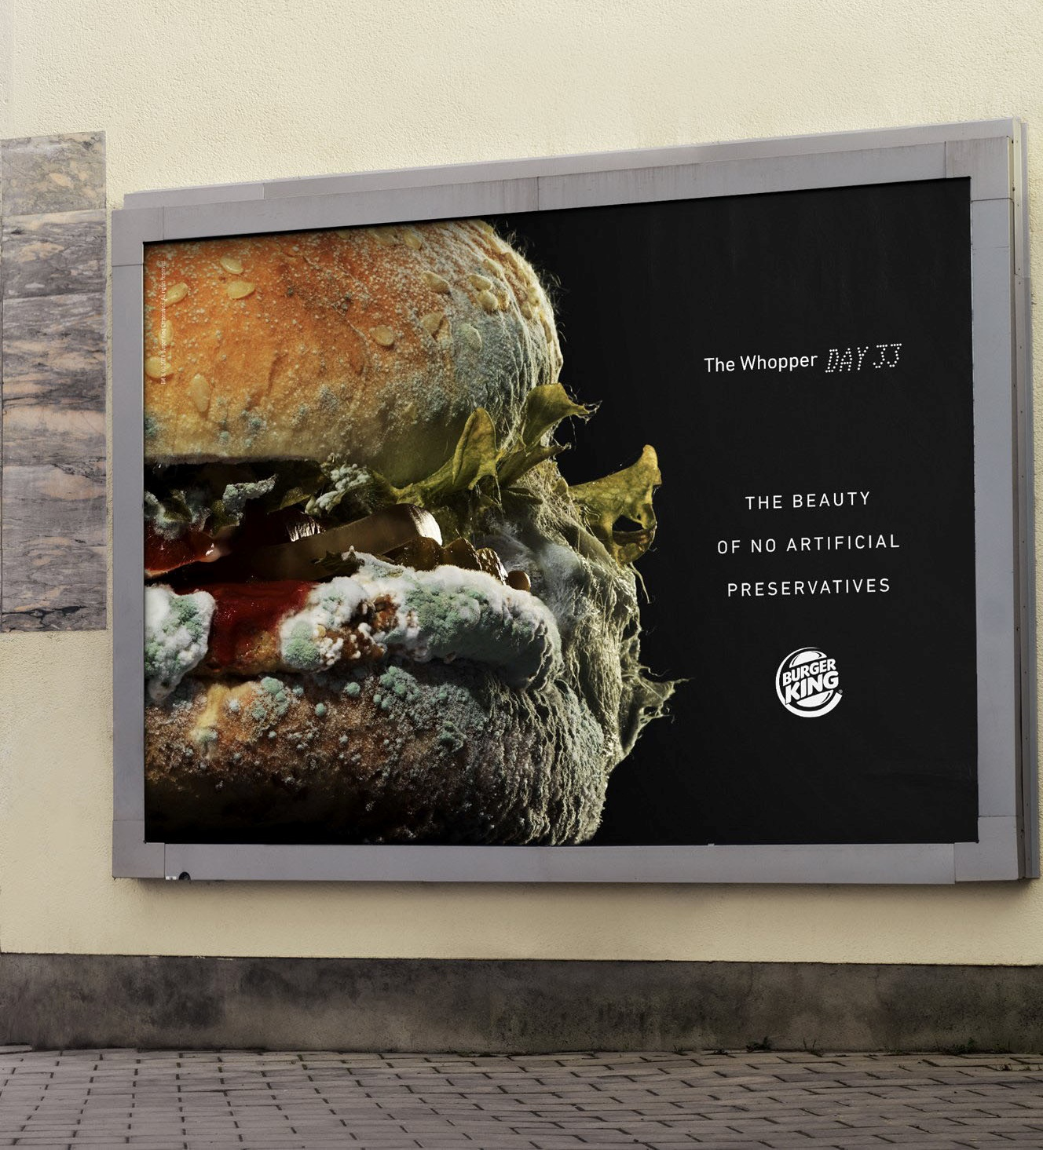
Entertaining
Entertaining
Surprising

Slide 4
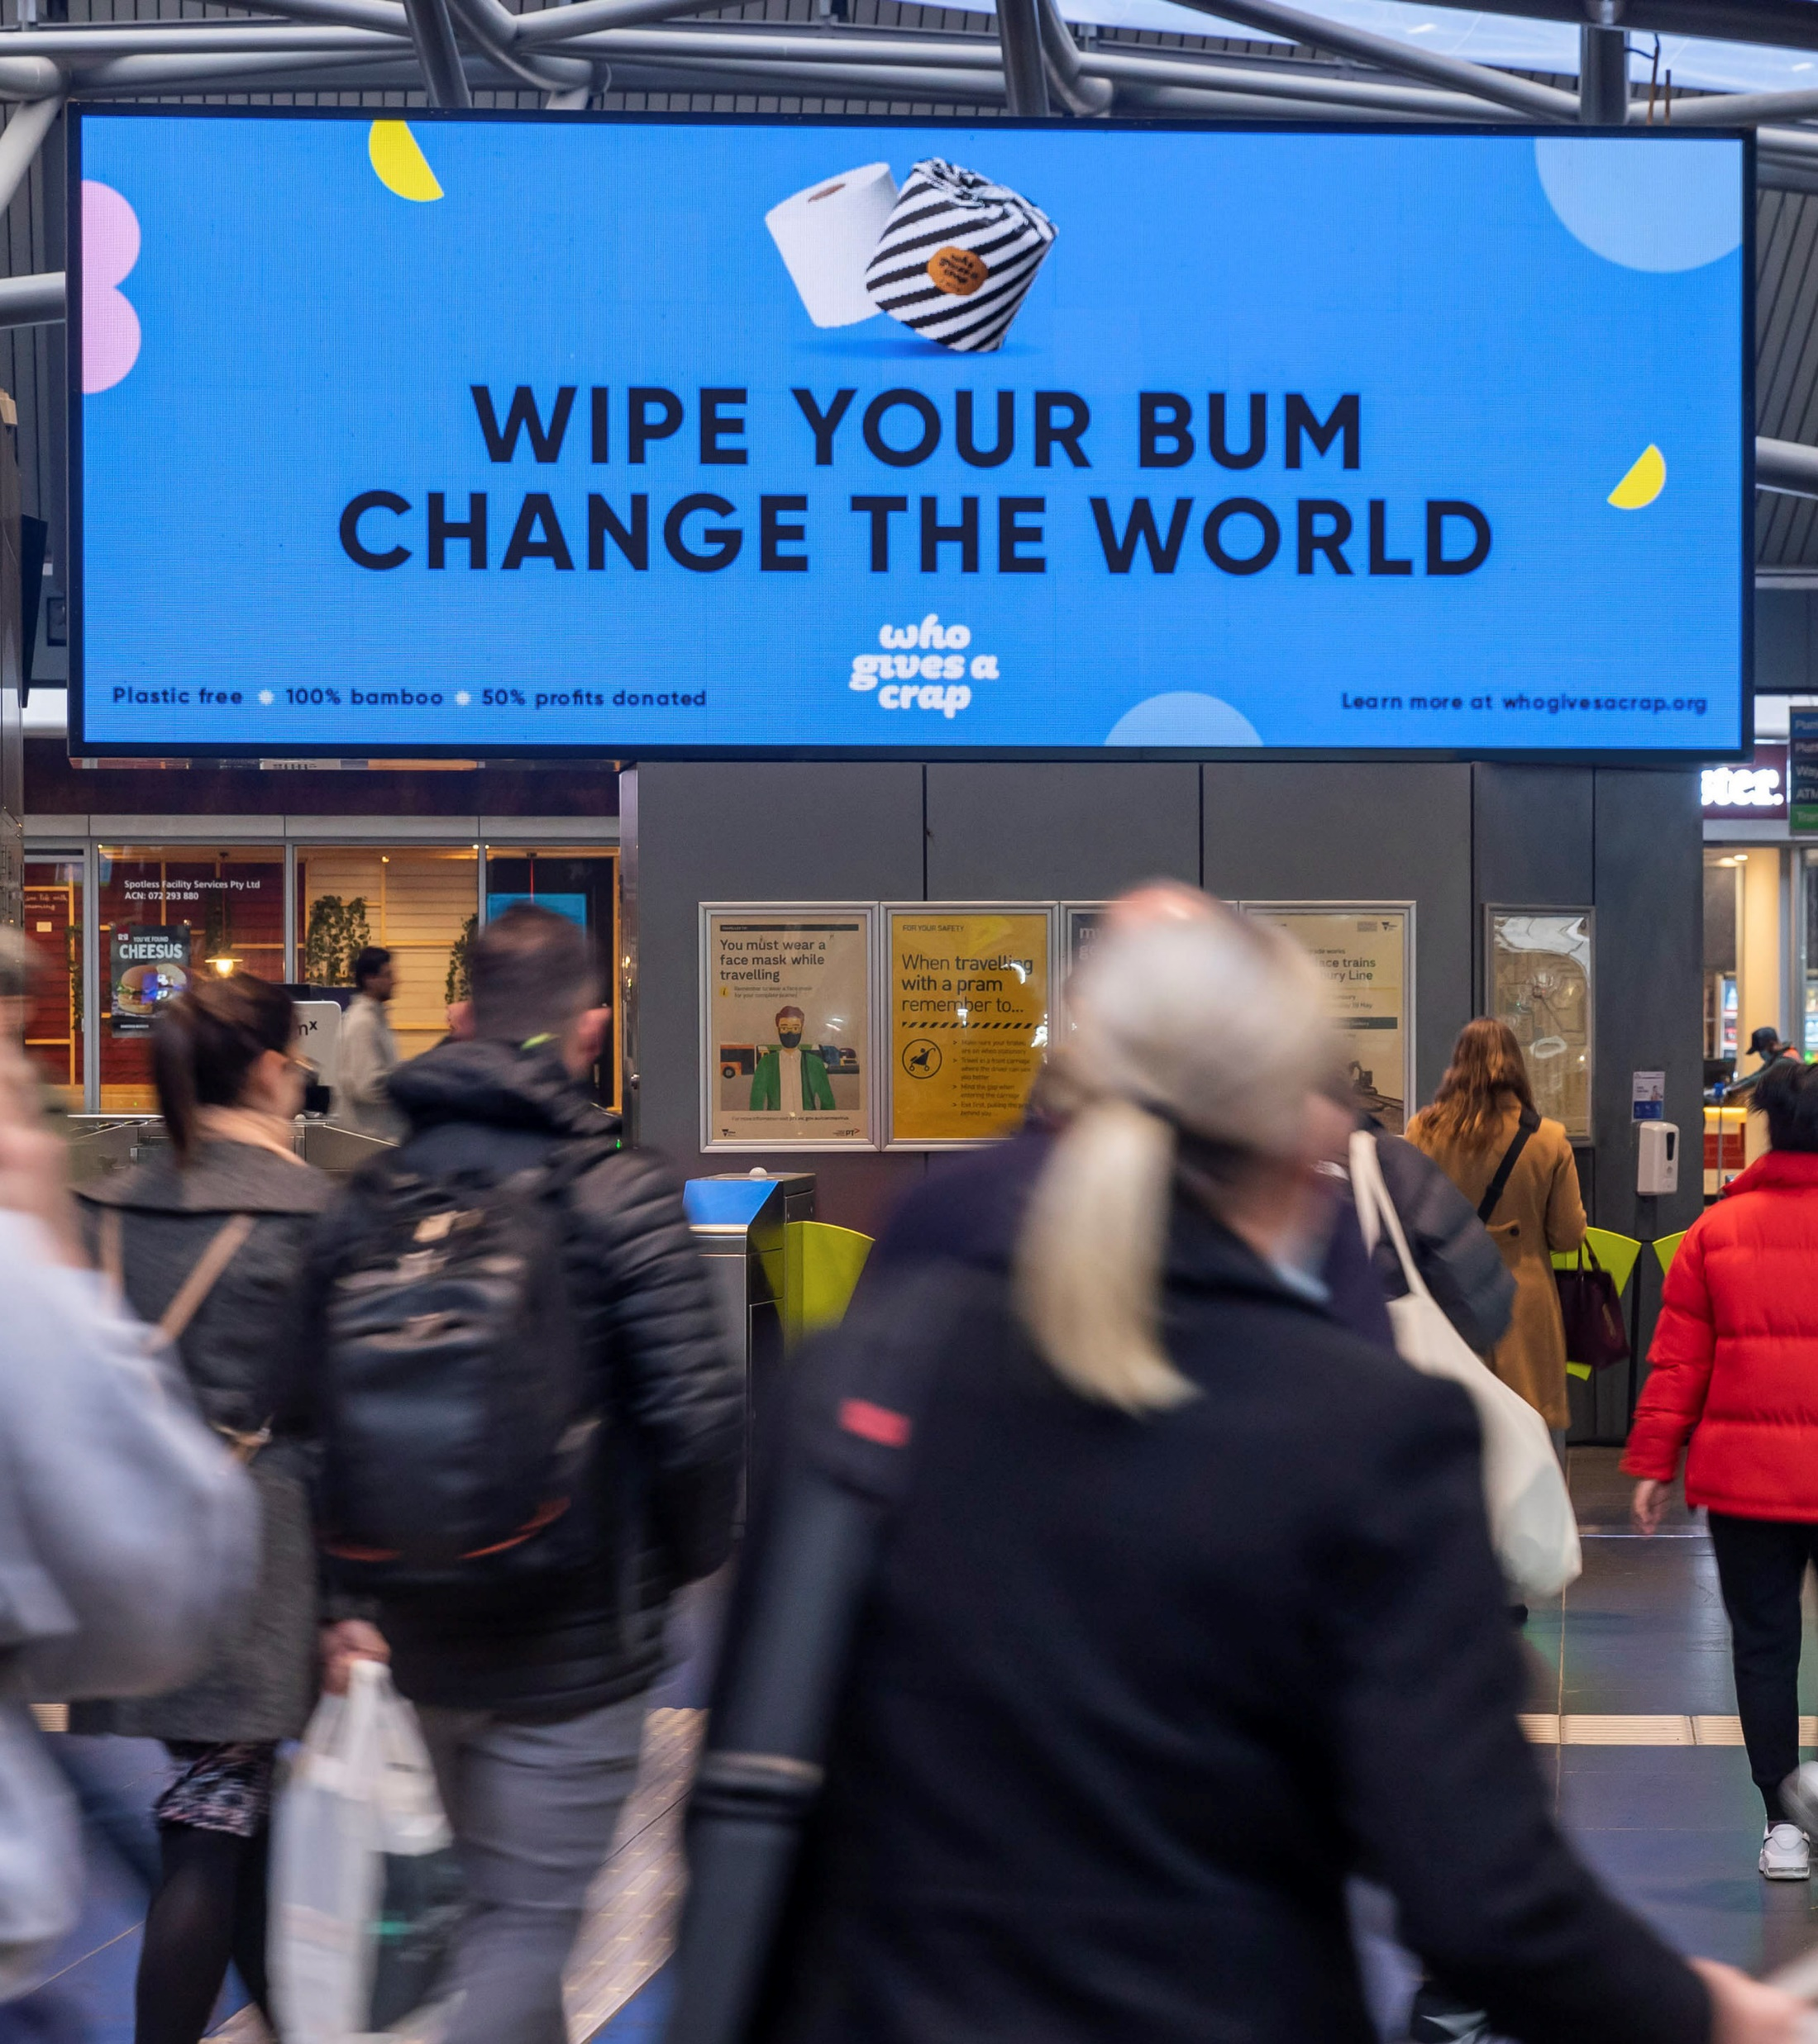
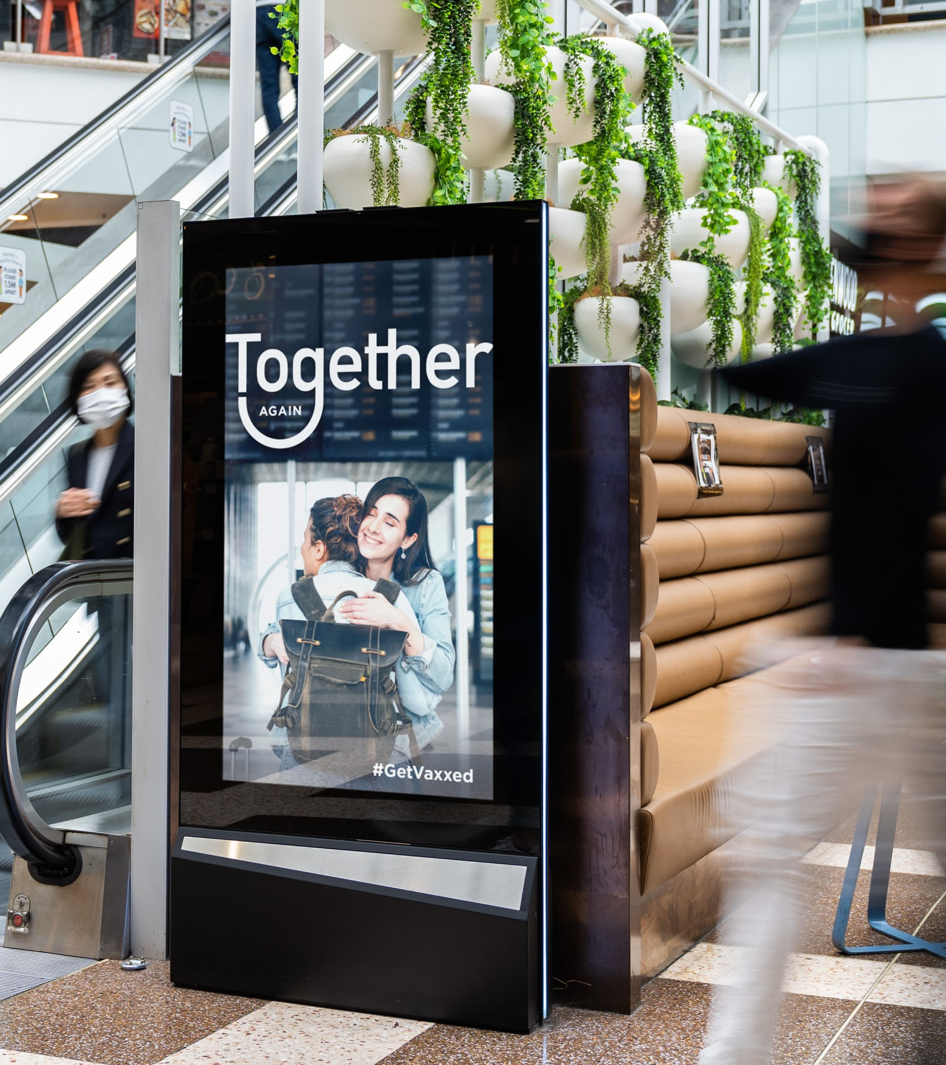
Humorous
Informative
Entertaining
Emotional

Slide 5
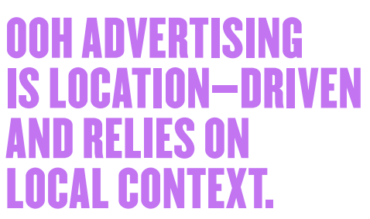
Placement
Roadside
Transport
Surroundings
Retail/ Lifestyle
— Bicycle stations
— Billboards
— Bus/tram externals
— Bus/tram shelters
— Kiosks
— Phone booths
— Public toilets
— Standing panels
— Airport externals
— Airport internals
— Bus interchanges
— Bus/tram internals
— Ferries
— Rail platforms
— Train externals
— Cafes
— Convenience stores
— Gyms
— Office buildings
— Petrol stations
— Shopping centres
— Universities

Slide 6
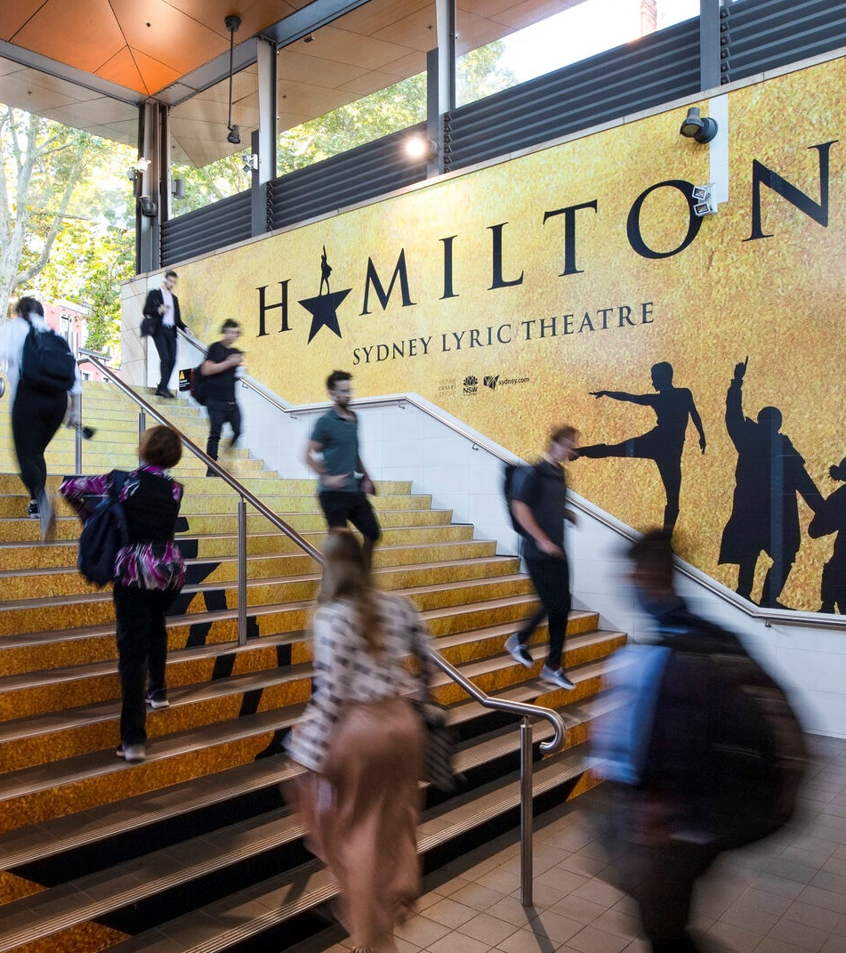
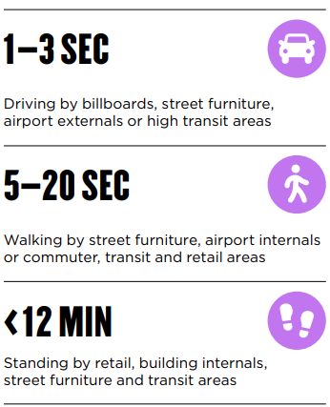
Audience Dwell Times

Slide 7
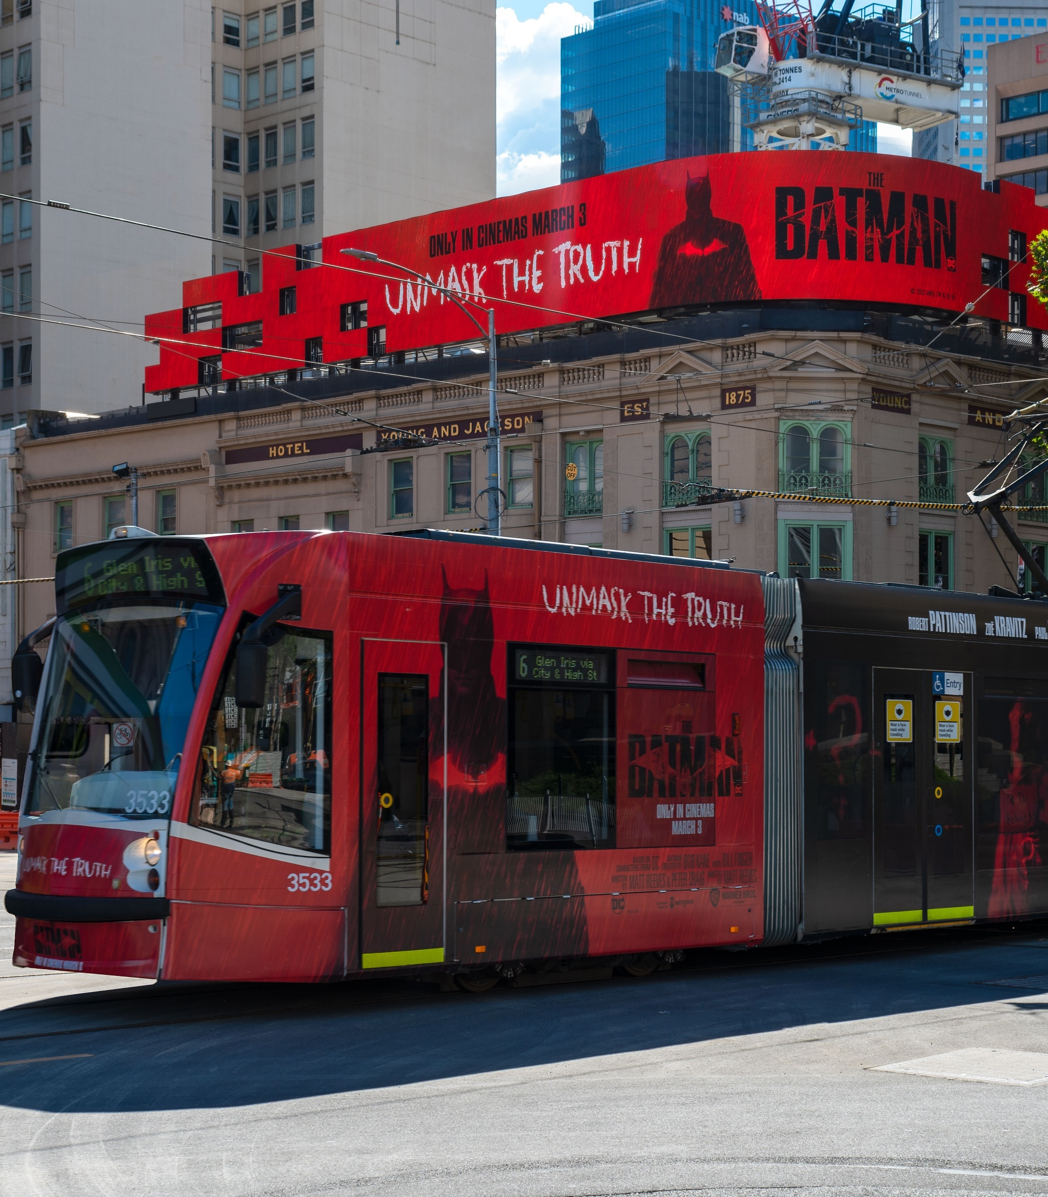
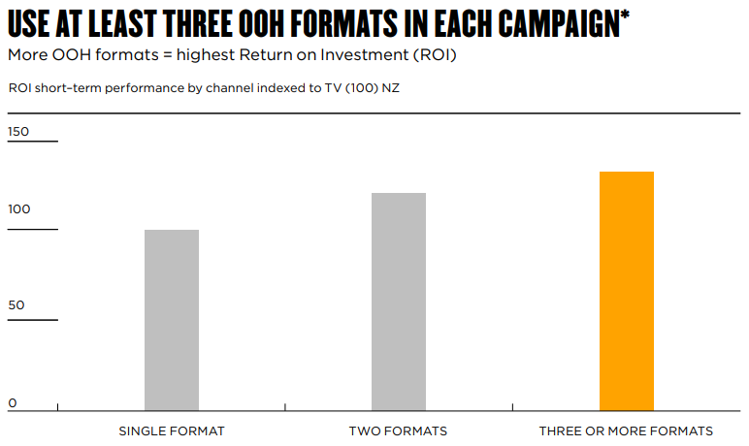
Use Classic & Digital
Together
Multi-Format

Slide 8
Digital Out of Home
63%
38%
MORE
MORE
Evolving creative Evolving campaigns are more memorable than static creative campaigns.
Digital signs have 63 per cent more neuro impact than classic signs.
Source: OMA study conducted by Neuro-Insight, Neuro Impact of Out of Home, September 2021.
Source: QMS and Neuro-Insight, Global First Neuro Study: Evolving Creative is More Memorable; May 2022.

Slide 9
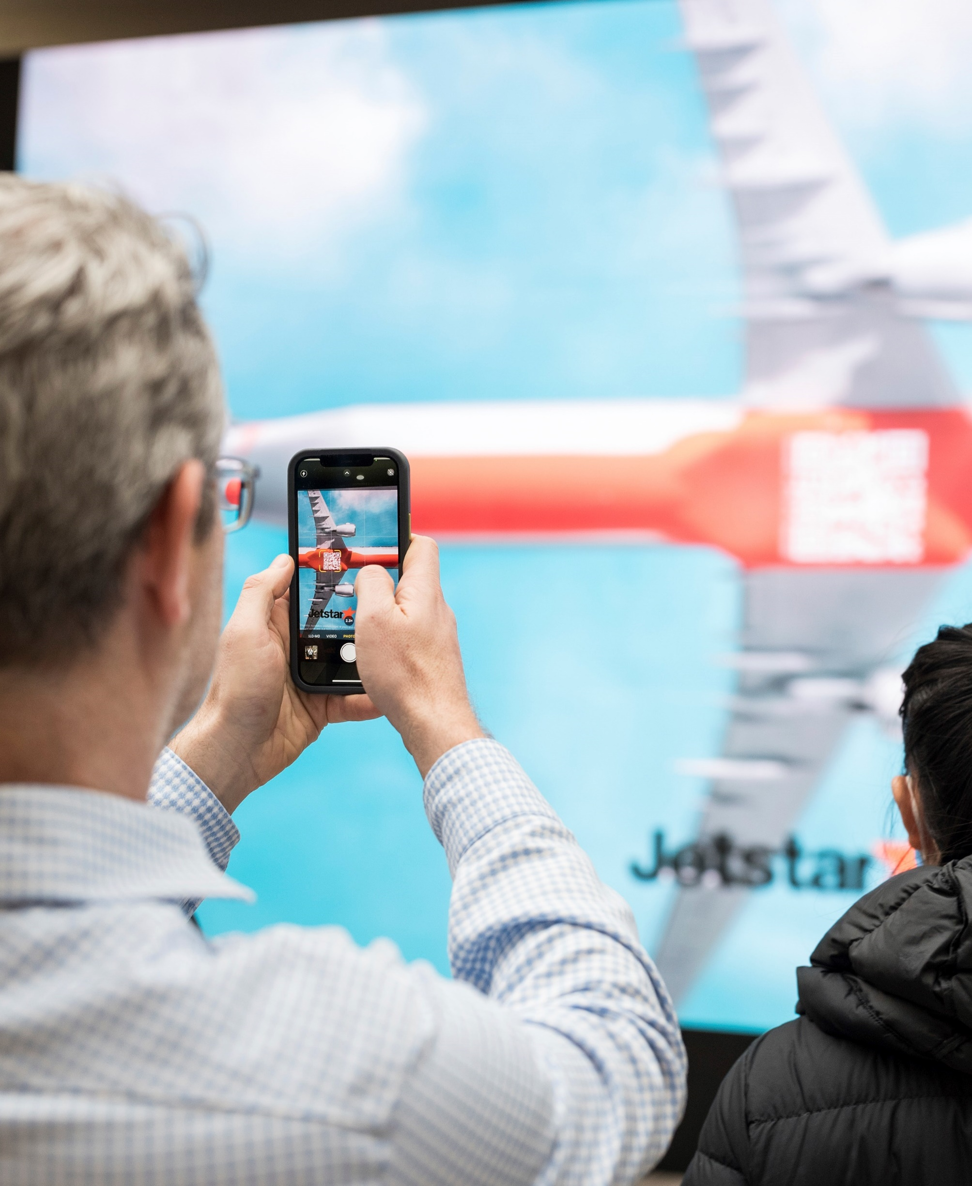
Digital Out of Home
QR Code
Weather Data
Time Data
Location Data
QR Code
Anamorphic Screens
3D Animation

Slide 10
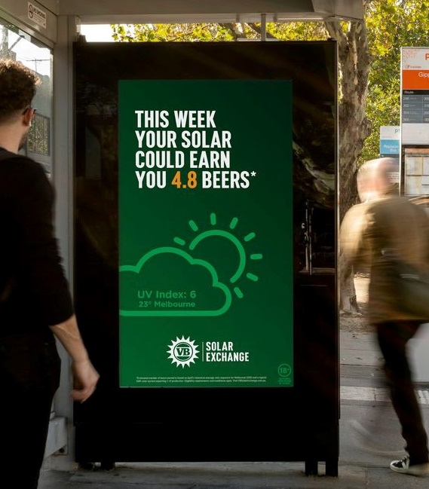
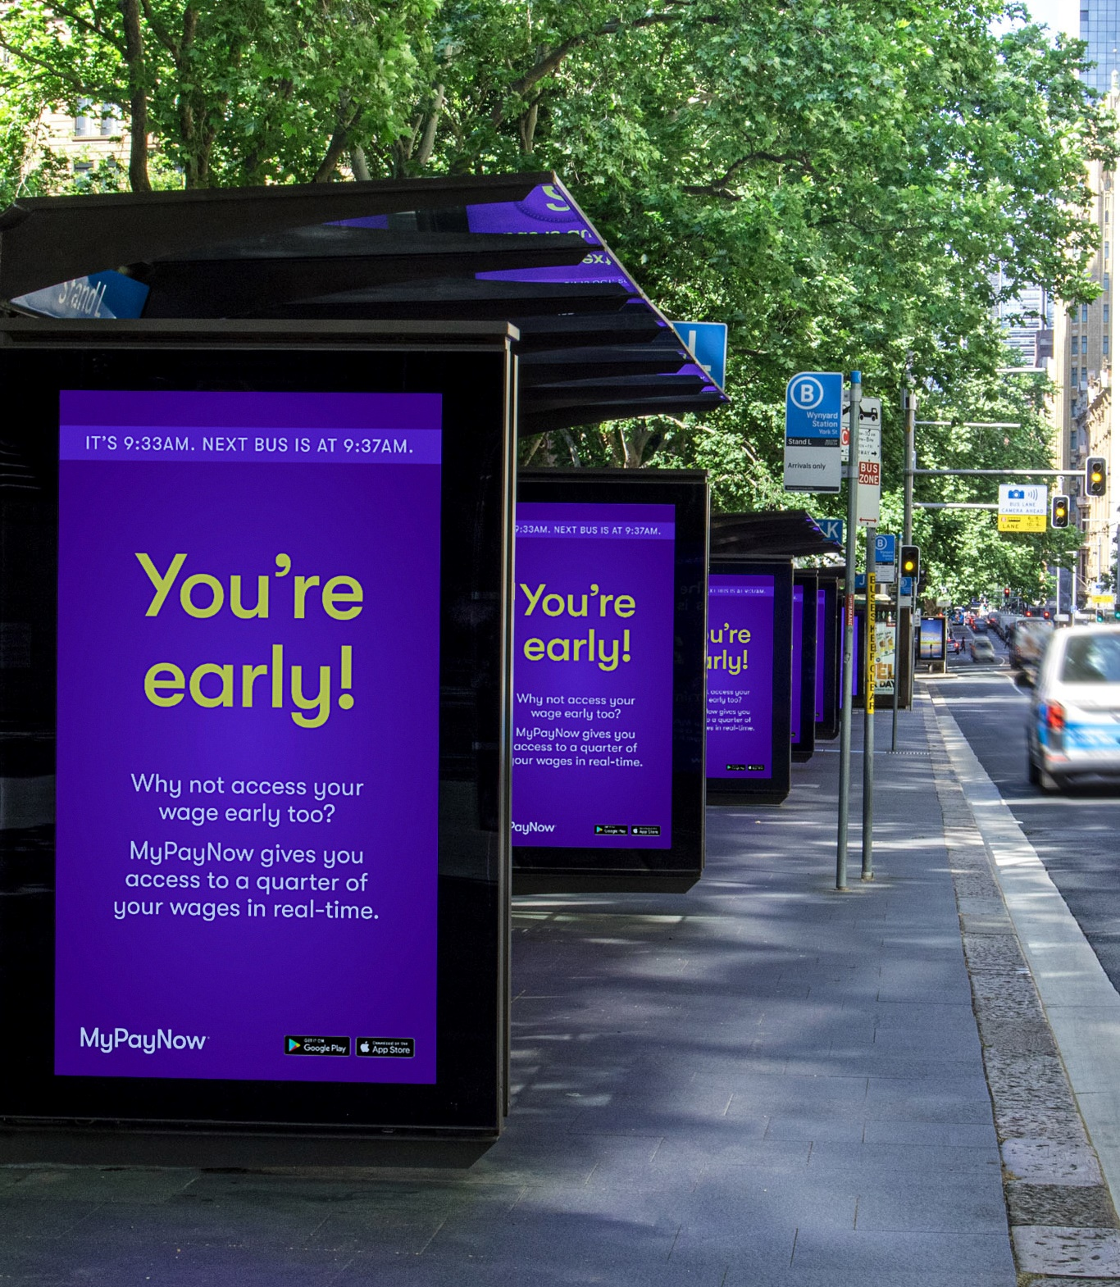
Weather Data
Time Data

Slide 11
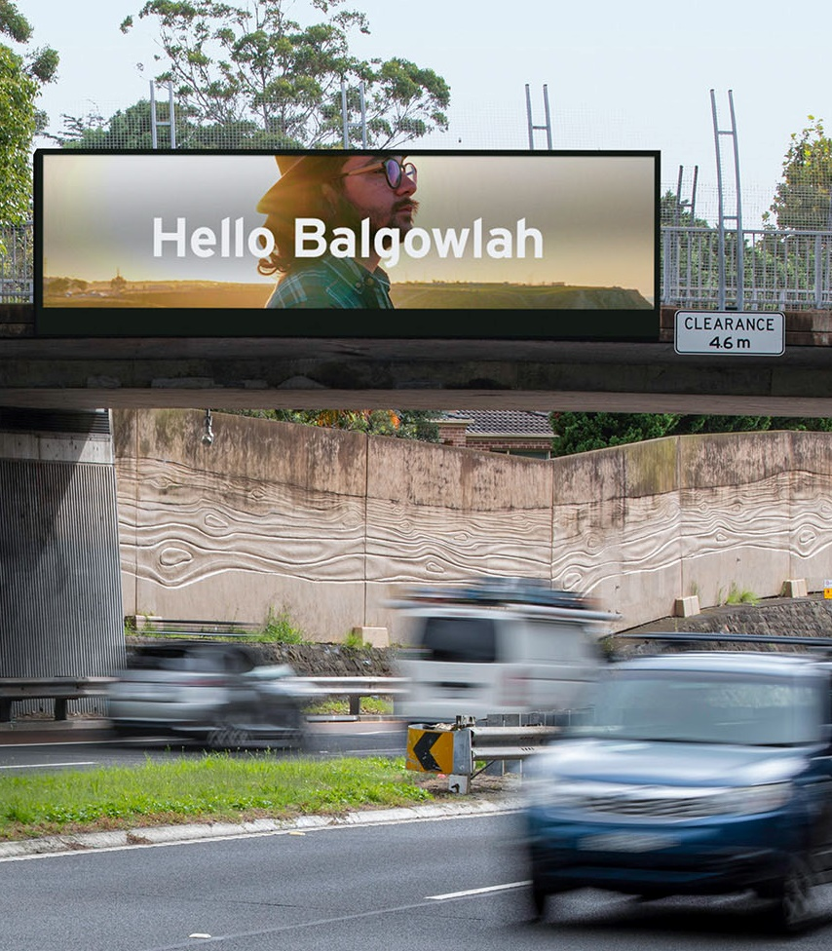
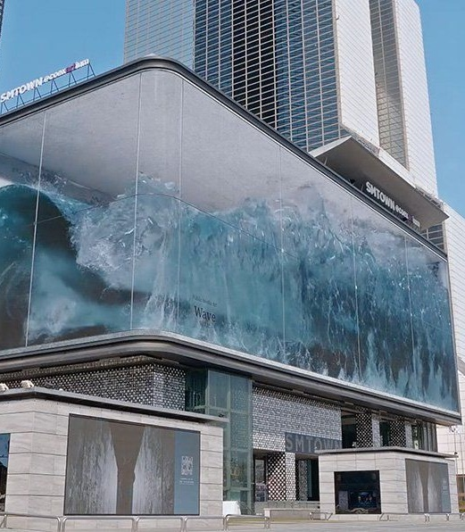
Entertaining
Location Data
Anamorphic Screens

Slide 12
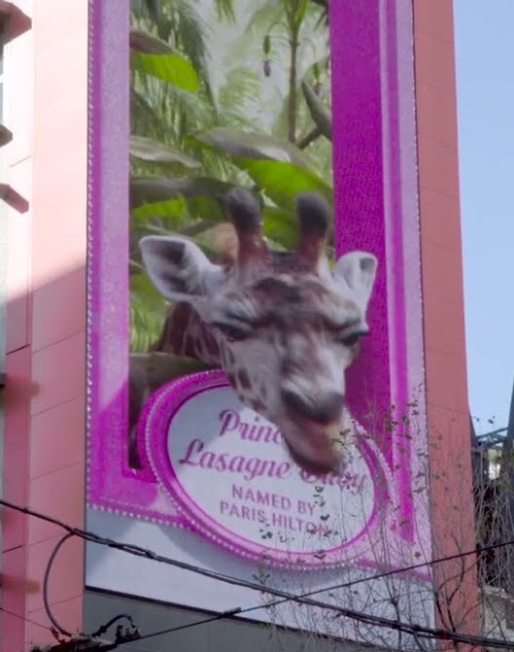
Entertaining
3D Animation
(Click to see video.)
Notes:
Link to UberEats campaign “Tonight I’ll be eating” with Irwins and Paris Hilton: www.vimeo.com/731918653?embedded=true&source=video_title&owner=9218992

Slide 13
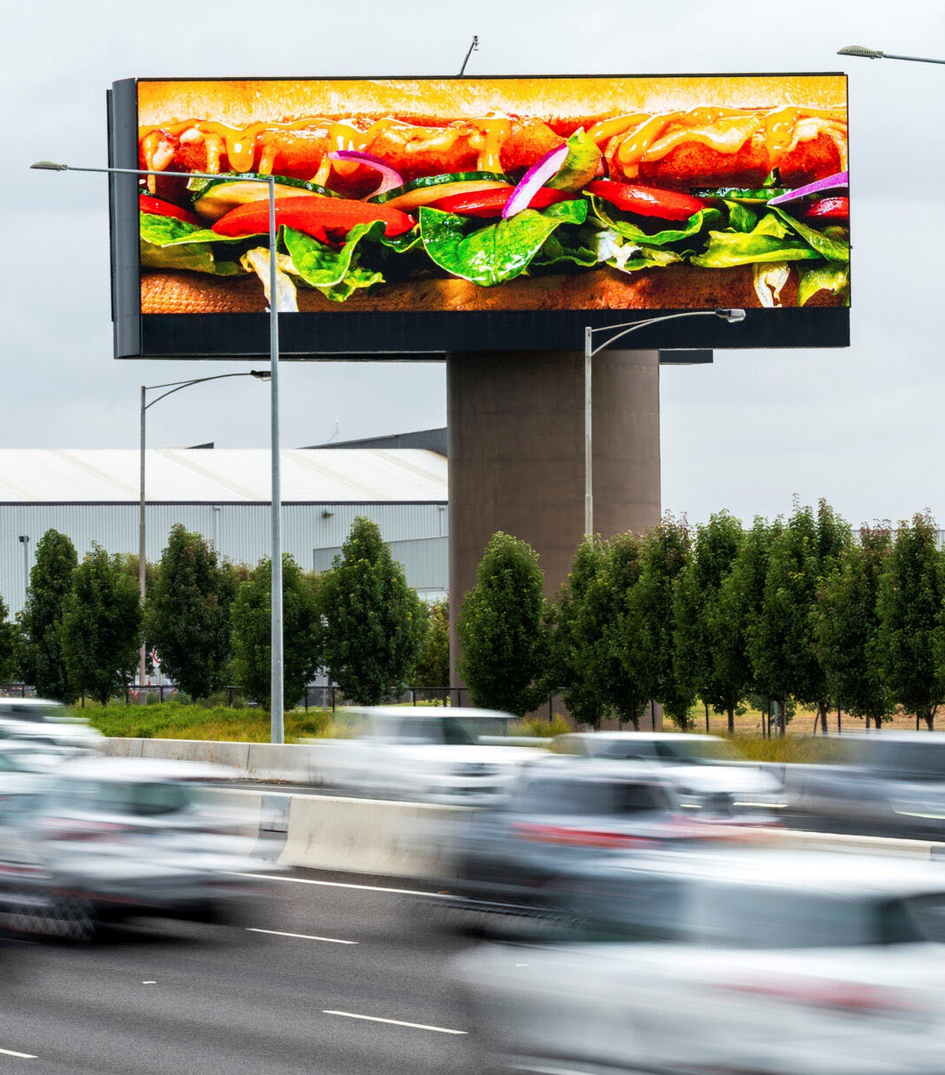
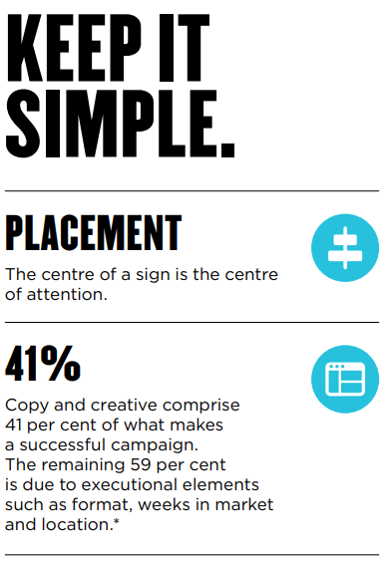
Creative Design

Slide 14
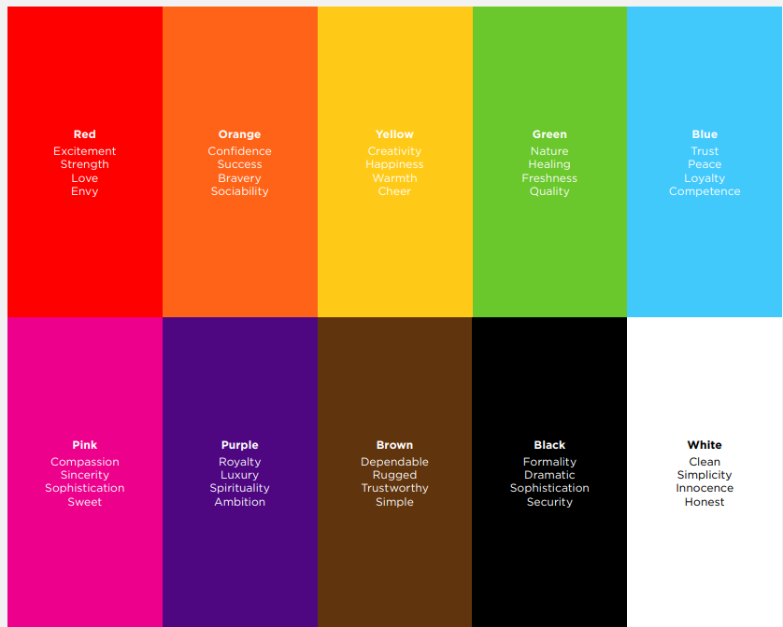
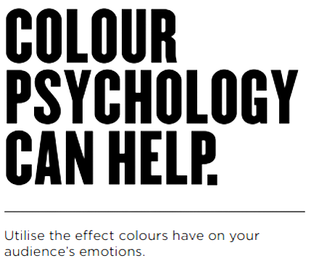
Colour Theory

Slide 15
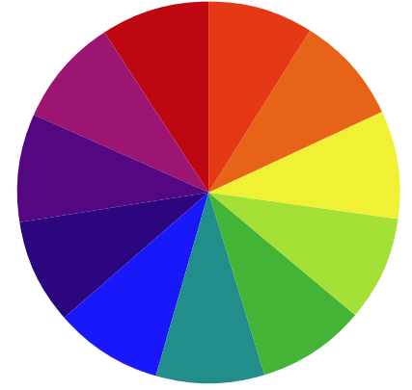
Colour Theory

Slide 16
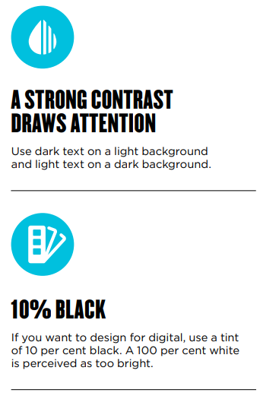
Readability

Slide 17
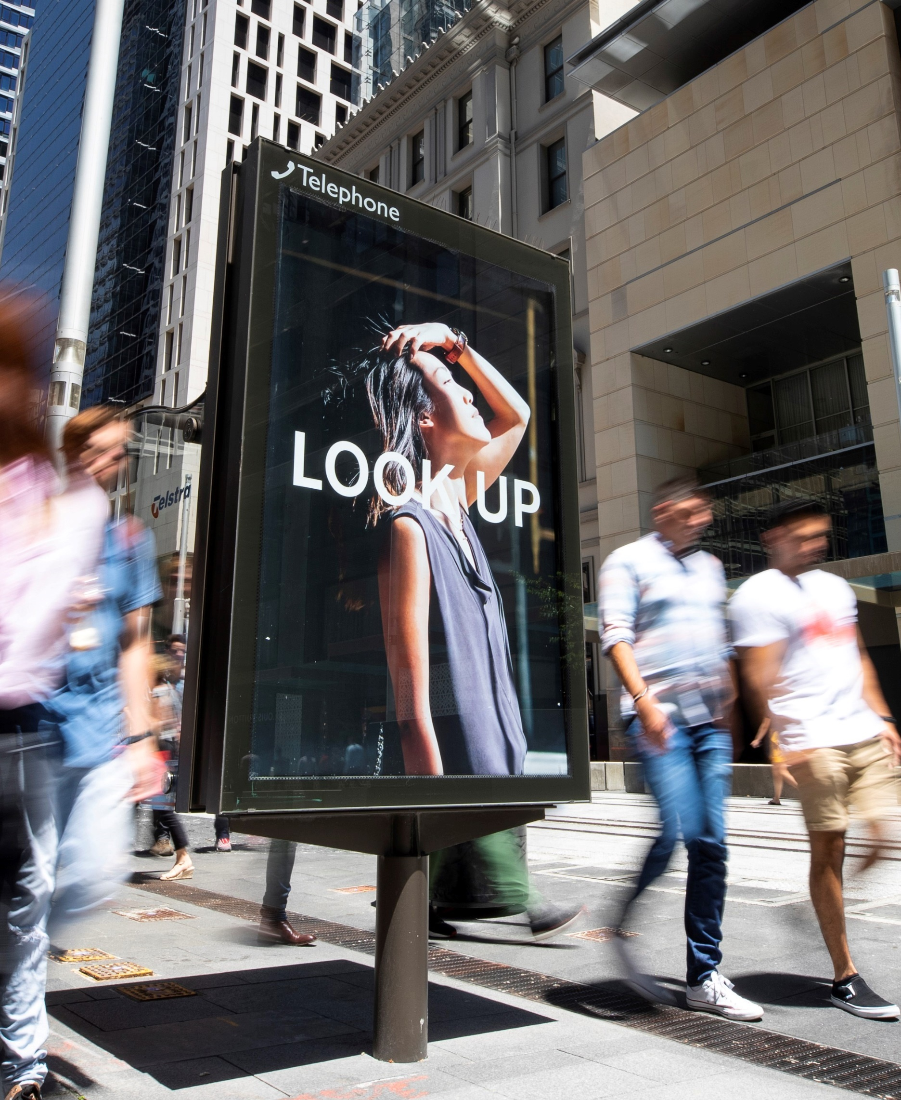
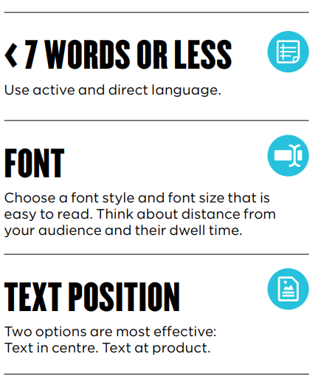
Copywriting

Slide 18
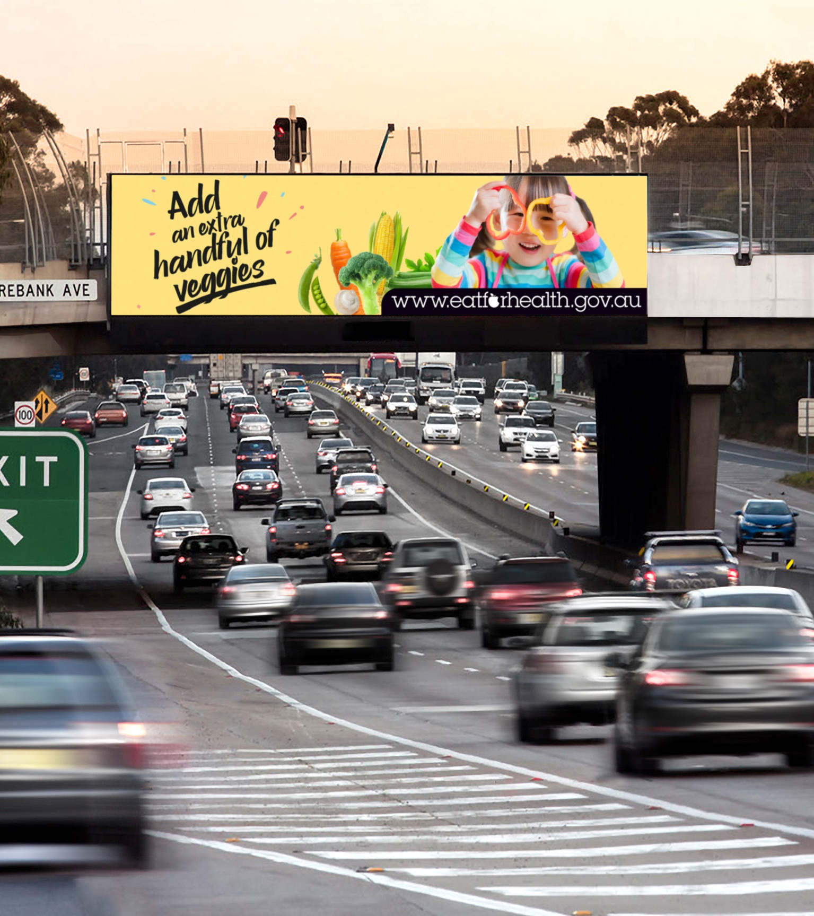
Regulation
Advertising in the public domain is visible to a broad audience, and OMA members are committed to ensuring that the advertising they post meets community standards. In addition to adhering to all applicable legislation and regulation, OMA members have adopted the voluntary industry principles in the OMA Code of Ethics.

Slide 19
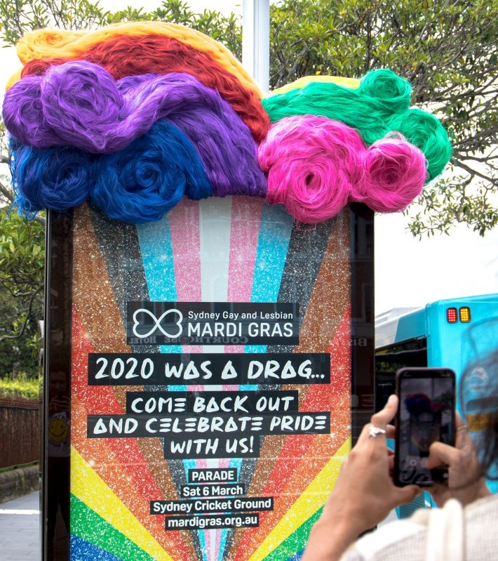
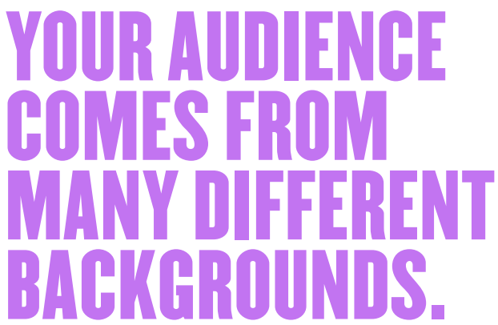
Diversity

Slide 20
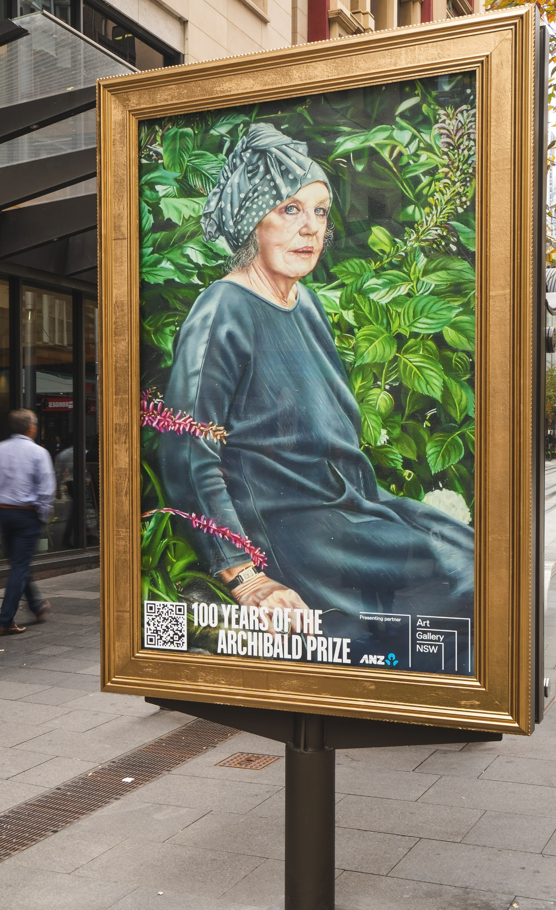
Excellence in OOH
The OMA Creative Collection celebrates the most creative OOH campaigns.
Big, Bold and Bright
Best Use of Digital
Best Use of Multi-Format
Innovation in Out of Home
Out of Home for Good

